Slide 1
COMP 1950
Web Development and Design 2

Slide 2
Day 02

Slide 3
Agenda
Typography
Custom Web Fonts
Responsive Web Design Tools
Media Queries
Fluid Responsive Layout

Slide 4
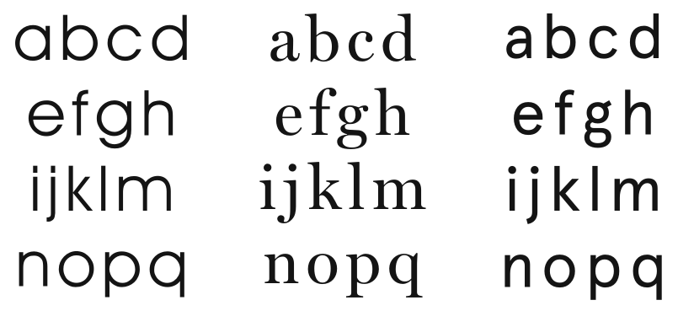
Typography for the Web
Above image from: http://pierrickcalvez.com/journal/a-five-minutes-guide-to-better-typography

Slide 5
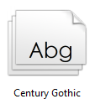
Terminology
G
Typeface
Is what we see. It is the artistic impression of how text looks, feels and reads¹
Font
Is a file that contains a typeface. Using a font on a computer allows the computer to access the typeface¹
Typeface = how text looks
Font = the file that contains the typeface
https://learn.shayhowe.com/html-css/working-with-typography/

Slide 6
General Typography Guidelines for the Web

Slide 7
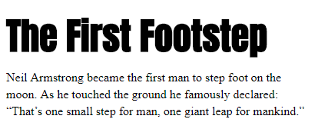
Choose One or Two Fonts for your Site
Keep your typeface choices to a minimum
Ideally 1 – 2 typefaces per site will suffice
A typeface for headings
A typeface for paragraphs, lists, links, etc
These are guidelines and there are always exceptions
The first footstep text from: https://www.cartridgesave.co.uk/news/15-of-the-most-iconic-newspaper-headlines-ever-printed/

Slide 8
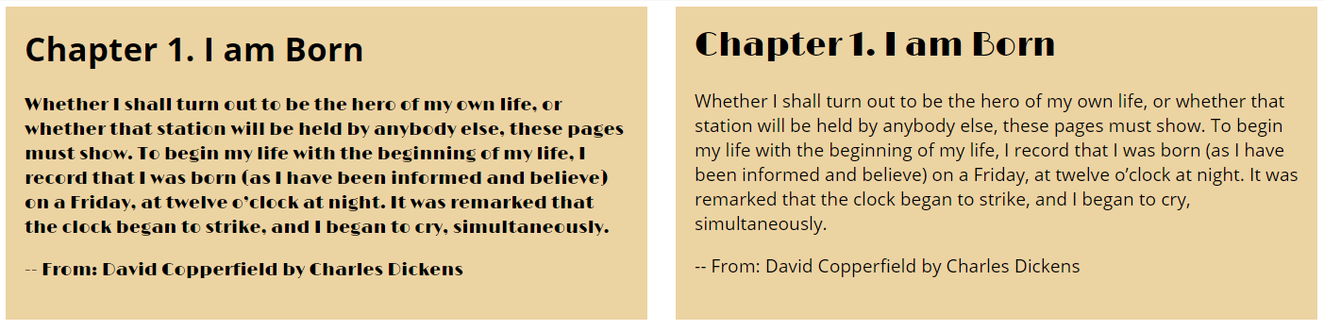
Use Decorative Typefaces for Headings Only
Decorative typefaces are great for headings, but reading long passages of text in a decorative typeface can be difficult
Decorative typeface used on a long passage of text is difficult to read
Decorative typefaces are best used on headings or short passages of text

Slide 9
Line Lengths
Don't let line lengths (called measure in print) get too narrow or too wide for long passages of text
A good rule of thumb for paragraphs in web design is between 40 and 80 characters per line or…
…using a 1rem or 16px font-size your paragraph container should range in size from 1000px to 320px
To keep your content fluid set a max-width property on the parent element instead of a fixed width property

Slide 10
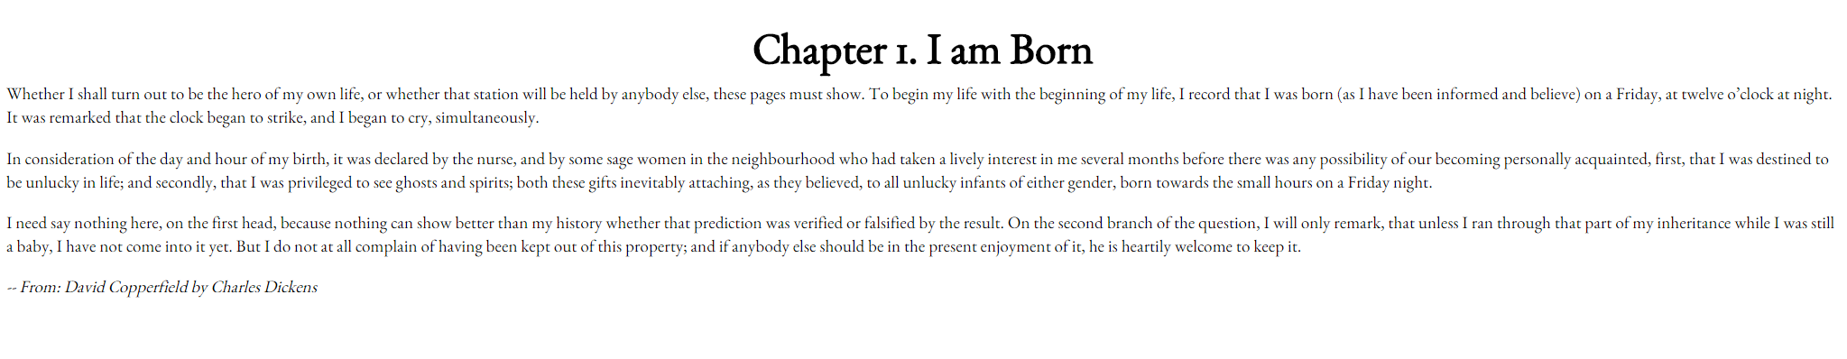
Line Lengths
Too wide

Slide 11
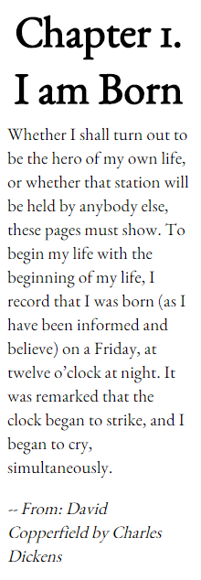
Line Lengths
Too narrow

Slide 12
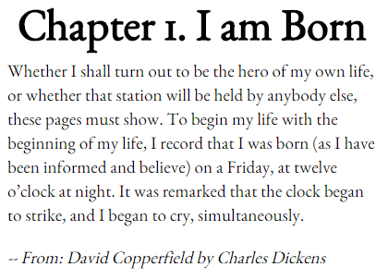
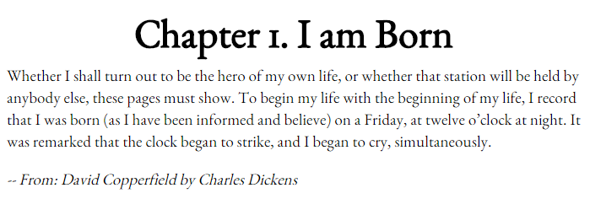
Line Lengths
About right

Slide 13
Type Size
Don't let your type size for main blocks of content get too small
16px or 1rem is a good size for general readability. This is the default type size for paragraphs in most browsers.
Smaller than 16px and type becomes difficult to read
Feel free to experiment with larger type sizes for paragraphs
Large paragraph type sizes on mobile can hamper readability due to the limited horizontal screen widths
Use media queries to adjust paragraph type sizes on desktop down to mobile

Slide 14
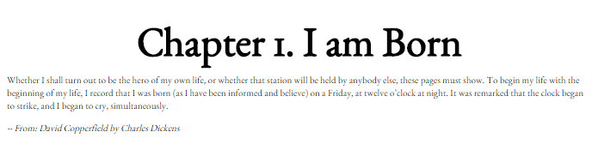
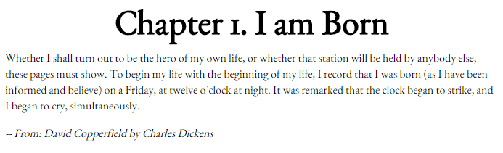
Type Size
Paragraph font-size set to 0.7rem. Too small for easy readability
Paragraph font-size set to 1rem. A good all around font-size that works from desktop down to mobile. This is the default in most browsers

Slide 15
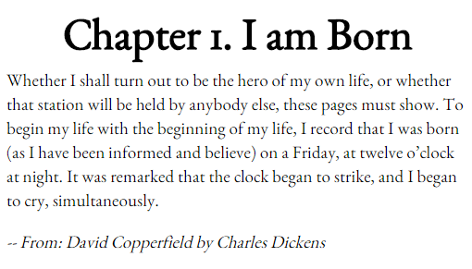
Type Alignment
When in doubt align left
Save centre alignment for headings
Centre aligned paragraphs are difficult to read
Justified alignment (CSS text-align: justify) can cause large amounts of empty space to form between words in your text on the web. Use text-align: justify; cautiously

Slide 16
Contrast
Make sure the color of the text has a high contrast relative to the background color
If in doubt test your type colour and your background colour at the Color Contrast Checker on WebAIM
https://webaim.org/resources/contrastchecker/
Be cautious when setting type on top of complex imagery

Slide 17
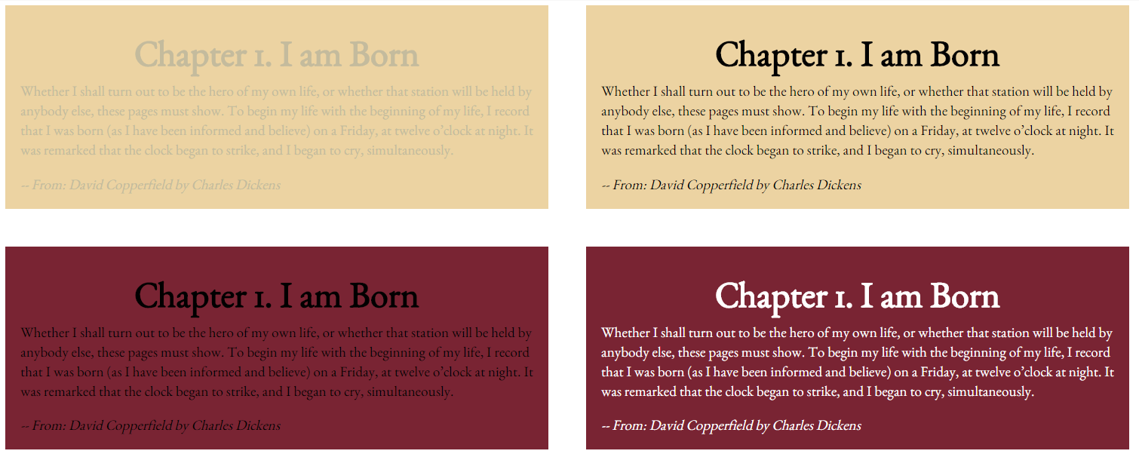
Contrast
Poor Contrast
Good Contrast

Slide 18

Type on top of Complex Imagery
Be cautious of text on top of complex imagery. It can be difficult to read

Slide 19
Line Height
Line height is the spacing between lines of text
When in doubt set a line-height of 1.4 on content text
Values between 1.2 and 1.5 work well in web design for long passages of content text

Slide 20
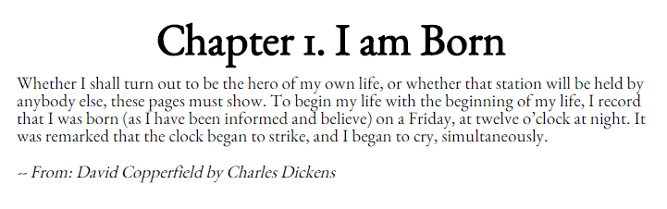
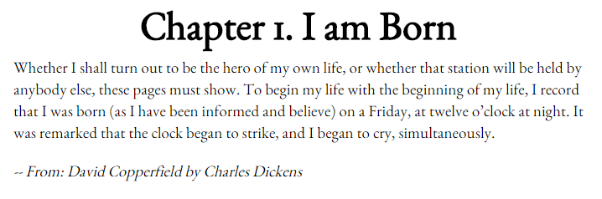
Line Height
Line Height set to 1. This is too low for good readability
Line Height set to 1.4, a good all around value for good readability

Slide 21
Let your Content Breath
Give your text content room to breath, meaning code in decent amounts of white space around text content elements
Text set right up against the edges of screens and parent elements are difficult to read
Set padding on parent elements to push text away from the edges of containing elements
Set margin between elements to space out elements in the overall page layout

Slide 22
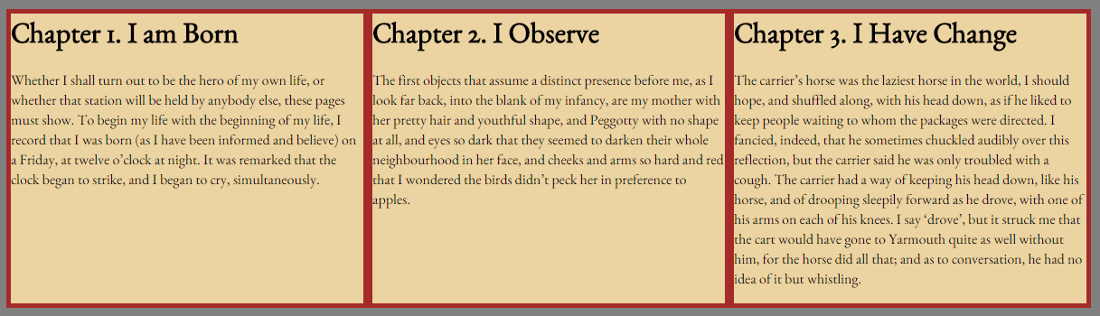
Content Spacing
Poor content spacing
Text is set right up against the edges of their parent elements hampering readability

Slide 23
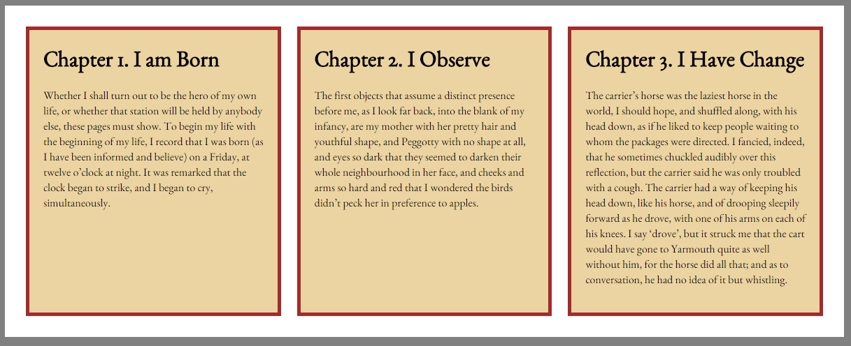
Content Spacing
Good content spacing
Elements are spaced away from the edges of their parent elements via padding
White space is set between each element via margin

Slide 24
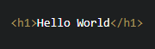
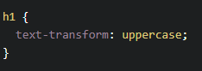

Use CSS to Set Capitalization
If you need headings in all-caps, use CSS, don't write the content in all CAPITAL letters.
This gives you the flexibility to change the capitalization at a later time via CSS without touching the content (HTML)

Slide 25
CSS Text Transform
text-transform values
none (default)
No capitalization. Text renders as it is from the HTML
capitalize
Transforms the first character of each word to uppercase
uppercase
Transforms all characters to uppercase
lowercase
Transforms all characters to lowercase
Above text modified from text found at: https://www.w3schools.com/cssref/pr_text_text-transform.asp

Slide 26
CSS Text Transform
Write your content in regular case.
Set your capitalization with CSS. If you want regular capitalization then do not set this or set it to "none"

Slide 27
Custom Typefaces on the Web
Until recently web developers were limited to the use of web-safe typefaces on web sites and web apps
In the past, to add a custom typeface to a web app or web site developers used image replacement or Flash.
Today we have @font-face with good support in all modern browsers
@font-face allows us to load any font file onto our web site as long as we have the legal license to do so

Slide 28
Fonts and Copyright
Just because you can does not mean you should
@font-face allows us to take any font file on our computer, upload it to our server and use it on our web site
Legally we can not do this unless we have a license which permits web use using @font-face
Ignoring this can open up content creators and owners to legal action
Most fonts located on your desktop are not licensed for @font-face use
Get fonts from web font services or use services like Google fonts to ensure you have a license to use the font on the web
We will explore some free and paid font services that you can use on your web site or web app

Slide 29
Using @font-face
Inside the @font-face declaration:
Declare a name for your font
Tell the browser where the font file is located
Specify the font format
Declare what font-weight the font is
Declare what font-style the font is
@font-face {
font-family: 'foo';
src: url('fonts/foo-type.woff2') format('woff2'),
url('fonts/foo.woff') format('woff'),
url('fonts/foo.ttf') format('truetype'),
font-weight: normal;
font-style: normal;
}
Code modified from: https://developer.mozilla.org/en-US/docs/Learn/CSS/Styling_text/Web_fonts

Slide 30
Using @font-face
@font-face {
font-family: 'foo';
src: url('fonts/foo-type.woff2') format('woff2'),
url('fonts/foo.woff') format('woff'),
url('fonts/foo.ttf') format('truetype'),
font-weight: normal;
font-style: normal;
}
Once you have declared your font in an @font-face declaration, simply call the font inside a CSS ruleset
p {
font-family: foo, sans-serif;
}

Slide 31
A Quick Note on Font File Types
You can use a standard desktop font file (.otf/.ttf) on the web but these file types are not optimized for web use.
OTF/TTF font file sizes will be larger then if using a web font file format

Slide 32
Web Font File Formats
Web Font file formats
EOT (IE6-IE8)
SVG (Old iPhone – Mobile Safari)
WOFF (IE9, Edge, Chrome, Safari, Mobile Safari, Firefox, Android)
WOFF2 (Edge, Chrome, Safari (partial), Mobile Safari, Firefox, Latest Android)
TTF (Edge, Chrome, Safari, Mobile Safari, Firefox, Android)
If you do not need to support IE6-8 than you can get by with just WOFF and WOFF2 font files for most modern browsers
Need to support older Android: use TTF or OTF font files
Need to support really old iPhones: use an SVG font file format

Slide 33
@font-face Format Order
In your @font-face declaration format order matters, so declare the most modern format first (WOFF2), followed by older formats
The browser will download the first format it understands
One exception
If you have to support IE6-8 then declare the EOT formats first followed by WOFF2, WOFF, TTF and SVG

Slide 34
@font-face – Modern Browser Support Syntax
@font-face {
font-family: 'foo';
src: url('foo.woff2') format('woff2'), /* Latest browsers – 2017 */
url('foo.woff') format('woff'); /* Modern browsers */
}
Code above modified from: https://css-tricks.com/snippets/css/using-font-face/

Slide 35
@font-face – Deep Browser Support Syntax
@font-face {
font-family: 'foo';
src: url('foo.eot'); /* IE9 Compat Modes */
src: url('foo.eot?iefix') format('embedded-opentype'), /* IE6-IE8 */
url('foo.woff2') format('woff2'), /* Latest browsers – 2017 */
url('foo.woff') format('woff'), /* Modern browsers */
url('foo.ttf') format('truetype'), /* Safari, Android, iOS */
url('foo.svg#svgFontName') format('svg'); /* Legacy iOs */
}
Code above modified from: https://css-tricks.com/snippets/css/using-font-face/

Slide 36
Free Fonts
Try these sites to get free fonts to use in your graphic designs, web sites and web apps
Double check licenses to make sure they are licensed for web use
On Font Squirrel look for the globe icon
Web Sites with free fonts
https://www.fontsquirrel.com/
https://www.dafont.com/
https://www.theleagueofmoveabletype.com/
http://losttype.com/

Slide 37
Font Hosting Services
Don't want to deal with @font-face declarations and hosting and serving your own font files, then use a font hosting service
Font Hosting services host your fonts for you
You declare fonts in your CSS file via the "font-family" property inside rulesets, but you do not need make an @font-face declaration
Some font hosting services require a small snippet of JavaScript in the head section. JS files are provided by the font hosting service

Slide 38
Paid Web Font Hosting Services
TypeKit
If you subscribe to Adobe's Creative Cloud, then you get TypeKit as part of your subscription
https://typekit.com/
Cloud Typography
https://www.typography.com/cloud/welcome/

Slide 39
Free Web Font Hosting Services
Google Fonts
The easiest to use and by far the most popular web font hosting service
Be careful with serving users in China as most Google services including fonts are blocked
https://fonts.google.com/
Adobe Edge Web Fonts
A nice alternative to Google
Good selection of Typefaces
Font quality is high
https://edgewebfonts.adobe.com/

Slide 40
Responsive Web Design

Slide 41
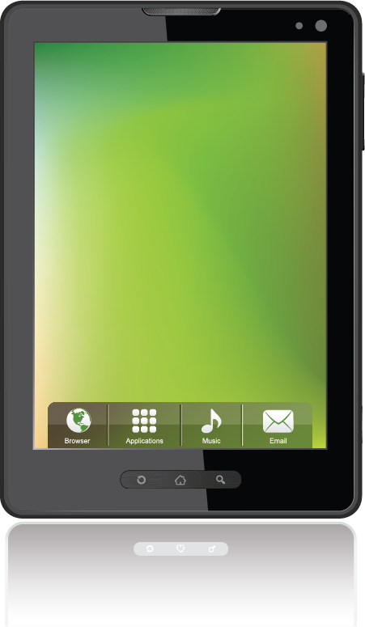
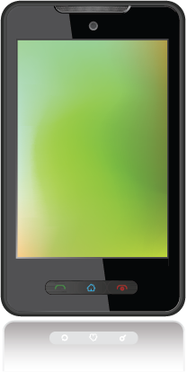
What is the Mobile Web
The Mobile Web refers to access to the world wide web, i.e. the use of browser-based Internet services, from a handheld mobile device, such as a smartphone, a feature phone or a tablet computer, connected to a mobile network or other wireless network.¹
http://en.wikipedia.org/wiki/Mobile_Web

Slide 42
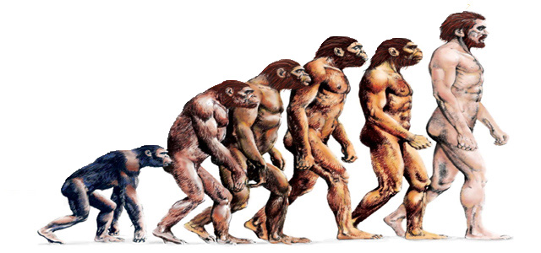
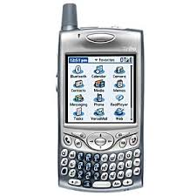
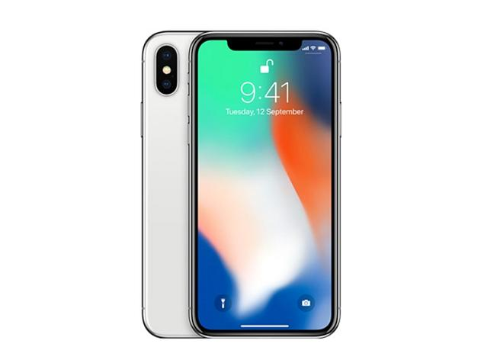
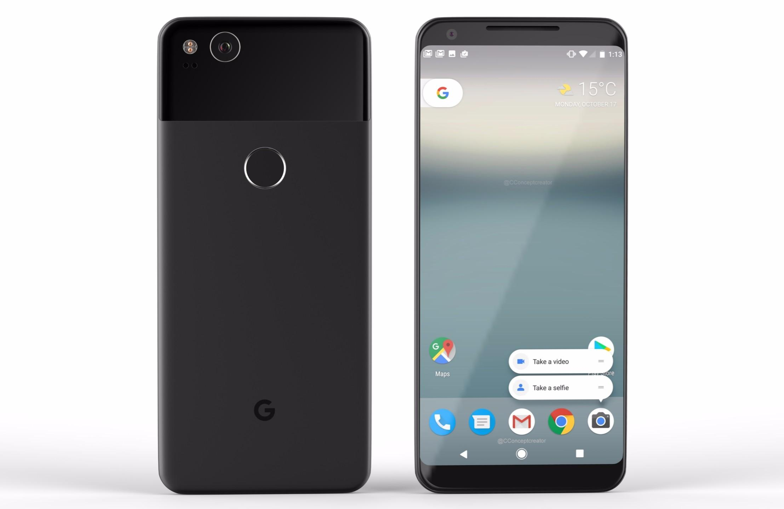
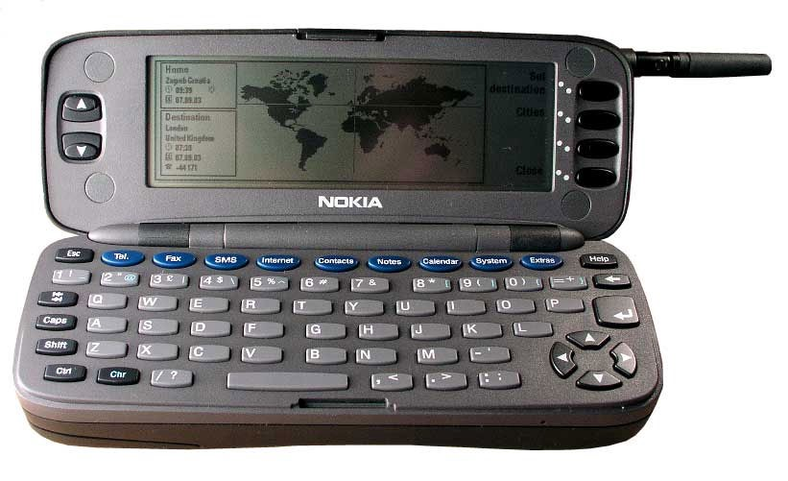
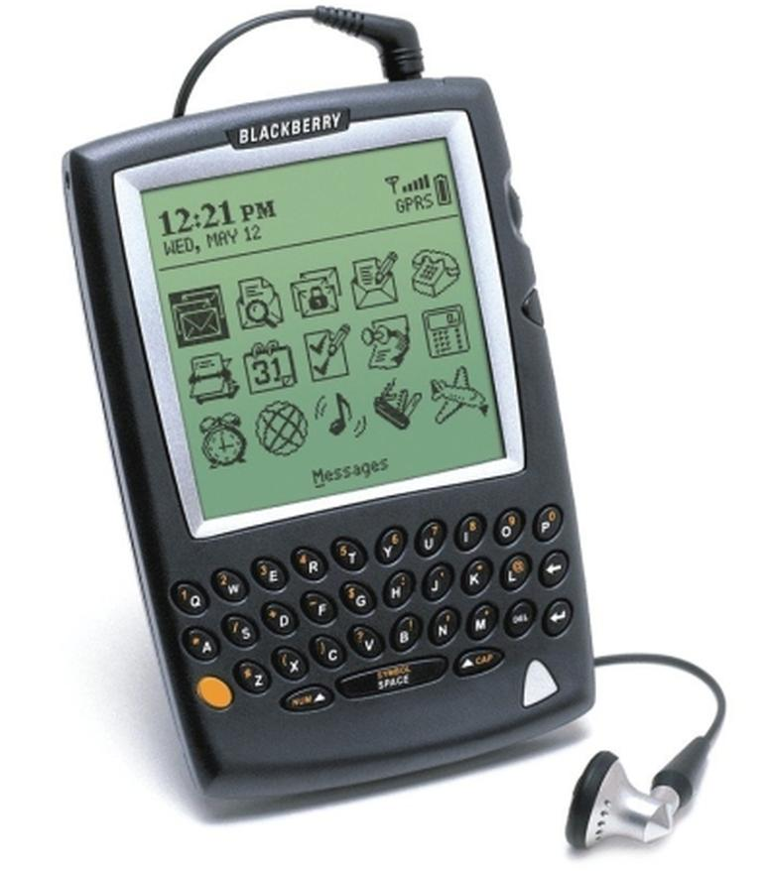
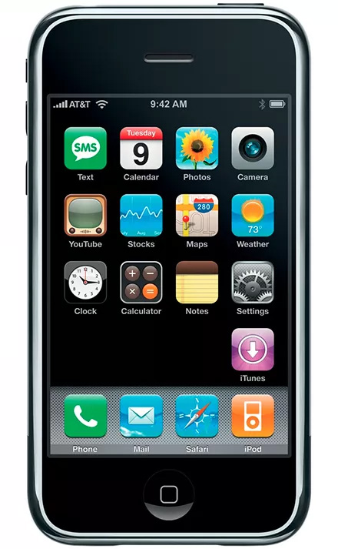
History of the Mobile Web
Evolution Image from: http://www.thehansindia.com/posts/index/Civil-Services/2016-09-26/How-culture-impacted-human-evolution/255872

Slide 43
Before iPhone
After iPhone
Relatively high powered devices
Full HTML5 compliant browsers that could browse the entire web
fast connectivity to the web
Low powered devices
Weak browsers that could only browse a sub set of the web
Slow connectivity to the web

Slide 44
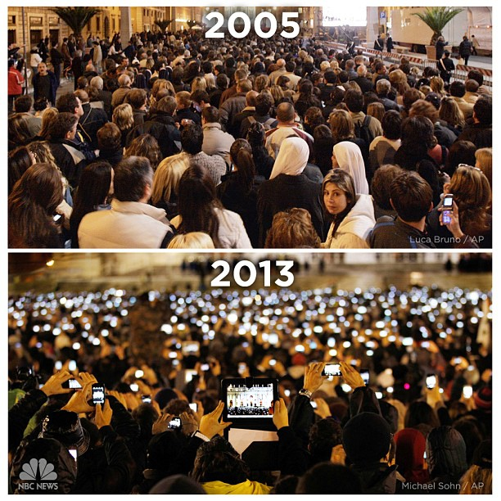
Why go Mobile
Source: http://instagram.com/p/W2BuMLQLRB

Slide 45
Global Smartphone Market Share
Chart data source: https://android.jlelse.eu/apple-vs-android-a-comparative-study-2017-c5799a0a1683

Slide 46
Class Poll - Smartphones

Slide 47
Responsive Web Design – Design Inspiration
http://mediaqueri.es
To see the different versions of these web sites, from desktop to tablet, simply resize your desktop browser window

Slide 48
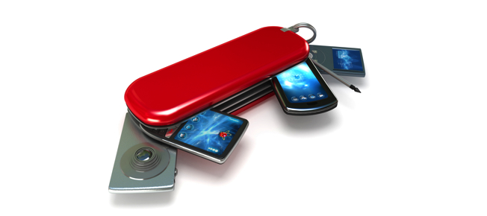
Responsive Web Design Tools
The above images from: http://contactlessintelligence.com/2012/07/06/smartphones-the-new-digital-swiss-army-knife

Slide 49
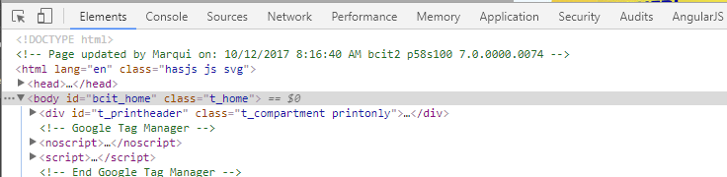
Browser Tools - Chrome
Activate developer tools and click the phone icon to activate device emulation
This is not a true emulator, it still uses the Chrome desktop rendering engine
This tool will give you a good idea of what your layout will look like at different device sizes

Slide 50
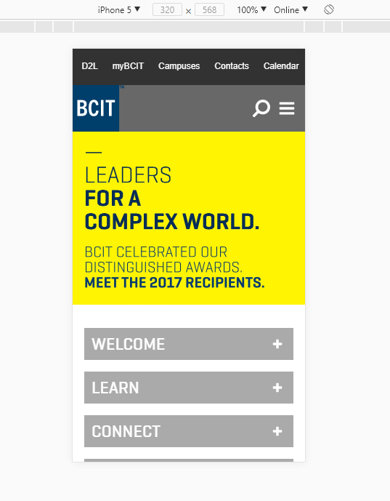
Browser Tools - Chrome
Once the device emulator has activated you can:
Resize to popular mobile device sizes
Resize to any browser size
Throttle connection speeds to simulate mobile connections
Change device orientation
Change pixel ratio

Slide 51

Browser Tools - Firefox
Firefox has a responsive design view
To activate it press:
On Windows: Ctrl + Shift + M
On Mac: Cmd + Option + M
Once the tool is activated you can:
Resize to any size, or resize to common popular mobile device sizes
Throttle connection speeds
Change device orientation
Change pixel ratio
Take a screebshot

Slide 52

Browserstack
Normally a paid service that allows you to test your web sites on multiple devices virtually using virtual machines running in the browser
Sign up for a free trial:
http://www.browserstack.com
Image source: http://www.browserstack.com

Slide 53
Browsersync
Free open source tool that allows you to sync up and test multiple browsers simultaneously
You can configure it so that shanges to CSS and HTML files are reflected immediately on save without a browser refresh
If your mobile devices are on the same Wi-Fi network then you can sync up your mobile browsers as well
Read the docs at:
http://www.browsersync.io
Browsersync spins up a simple web server, that also injec

Slide 54
Browsersync - Install
To get it up and running follow these steps
Install Node JS - https://nodejs.org
Open a Node JS Command Prompt on Windows or open Terminal on Mac and type:
npm install -g browser-sync
Navigate to your project folder in Command Prompt or Terminal and type:
browsersync start --server --files "*.html, styles/*.css"
The above command assumes the following:
Your CSS files are stored in a directory called "styles" change this directory in the above command if needed

Slide 55
Browsersync – Install - Mac
Have problems installing on a Mac
Easy fix is to preface the npm install -g browser-sync command with "sudo"
sudo npm install -g browser-sync
Most developers do not like this approach as it can be risky to give any program root user permissions
A better approach is to change file permissions on the default npm install directory. Follow the instructions on this page:
https://docs.npmjs.com/getting-started/fixing-npm-permissions

Slide 56
Responsive Design Tools - Mac
If you have a Mac you have access to a couple of extra responsive design tools
The iOS emulator
This is a full emulator running a full recreation of an iOS device on your Mac
Emulates several iOS devices including iPads and iPhones
Plug an iPhone or iPad into your Mac and run browser developer tools on it via the desktop Safari Browser

Slide 57
iOS Simulator
You can get the iOS Simulator by installing X-Code from the App store. X-Code is used for developing iOS and Mac apps. Its free
To run it
Launch Xcode
Run the iOS simulator
Right click on the Xcode dock icon (or two finger tap)
Select "Open Developer Tools"
Select "Simulator"
For easier future access
Right click on the Simulator icon in the dock (or two finger tap)
Select Options
Select "Keep in Dock"
To run the Simulator in the future, simply click on the Dock icon

Slide 58
Plug an iPhone/iPad into your Mac for Testing
Make sure developer tools is enabled in both iOS Safari and Mac OS Safari
iOS Safari
Settings > Safari > Advanced > Web Inspector (enable this)
Mac OS Safari
Preferences > Advanced > Check "Show Develop Menu in Menu bar"
Plug your iOS device into your Mac and launch the web site you wish to test in iOS Safari
In Mac OS Safari
Develop > [Your iOS device] > Develop on this device
In Mac OS Safari
Develop > [Your iOS device] > select the web site you wish to run developer tools on

Slide 59
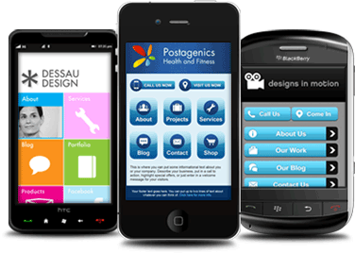
Coding Mobile Web Sites
Above image from: http://tytaniummobile.com/mobile-gallery-mobile-website-design-examples-qr-codes-lead-capture-pages

Slide 60



Coding Mobile Web Sites
The code for a mobile / responsive web site is very similar to coding a regular HTML coded web site
Just like desktop web sites we will use the following languages to code our sites
HTML – for content
CSS – for presentation
JavaScript – for behaviours
Behaviour = JavaScript
Content = HTML
Style = CSS

Slide 61
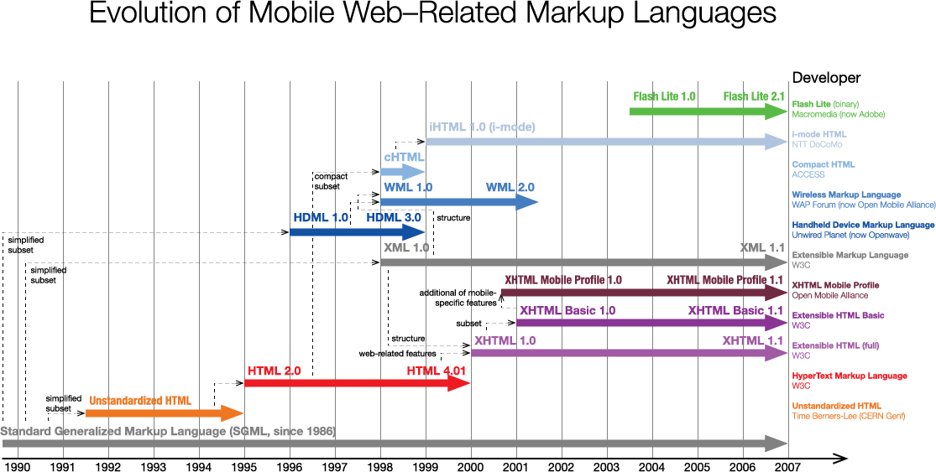
The above image from: http://en.wikipedia.org/w/index.php?title=File:Mobile_Web_Standards_Evolution_Vector.svg&page=1

Slide 62

Today

Slide 63
Components of a Responsive Web Site or App
Viewports
Setting your viewport meta tag
Flexible or Fluid layouts
Setting up a fluid grid system
Media Queries
Responsive Images and Media

Slide 64
Setting Up Your Viewport for Mobile Browsers

Slide 65
First, A little bit on the humble pixel
What is a pixel (px)
In none-web development terms a pixel is a single unit on a screen capable of displaying a colour
In web development terms a pixel is an abstraction from device pixels. When we set a width of an element with CSS or JavaScript to pixels we are setting CSS pixels not device pixels

Slide 66
CSS Pixels vs Device Pixels
As mentioned before device pixels are physical elements on a screen.
CSS pixels are an abstraction from device pixels set independently by the browser vendors
On most desktop non-retina screens 1 CSS pixel = 1 device pixel
If the user zooms into a web site using the zoom controls than 1 CSS pixel may equal multiple device pixels
On retina (or Hi-DPI) screens 1 CSS pixel can equal 4 or more device pixels
Every iPhone since the iPhone 4 is retina
Most modern Android phones are Hi-DPI devices
Recent MacBook Pros are retina

Slide 67
CSS Pixels vs Device Pixels
Set the width of an element in CSS to 200px and the element will take up different amounts of device pixels depending on the device and the browser
On an iPhone4 and higher the element with a CSS pixel width of 200 will actually take up 400 device pixels (width)
Fortunately for us Web Developers we need not really concern ourselves with the difference as the calculation between CSS pixels and device pixels has been abstracted away. We simple set our element to 200px and we expect it to appear to be 200px wide.
Even JavaScript will report an elements width back to us in CSS pixels

Slide 68
CSS Pixels vs Device Pixels, Who cares?
Since it has been abstracted away, you can largely forget about the theory, and code away knowing your CSS pixels or JavaScript pixels will appear on any screen as expected
Where it comes into play is setting up the viewport for mobile screens and creating retina or HiDPI ready imagery

Slide 69
Viewports 101
The viewport on desktop screens is simple
The viewport width is equal to the browsers width
The viewport on Mobile is a little more complex
Setting the viewport width equal to the browsers width on mobile devices would cause problems for sites not designed for mobile (a big problem when the iPhone came out in 2007 as most sites were not designed for mobile)
Mobile browsers realized this and made their browsers viewport width independent of the physical pixel dimension of the device
Mobile browser viewport widths range anywhere from 768px to 1024px (CSS pixels not device pixels)
Basically the Mobile browser zooms out to fit a desktop site into a mobile browser
This compromise was needed in the early days of the mobile web but causes problems for sites designed for mobile

Slide 70
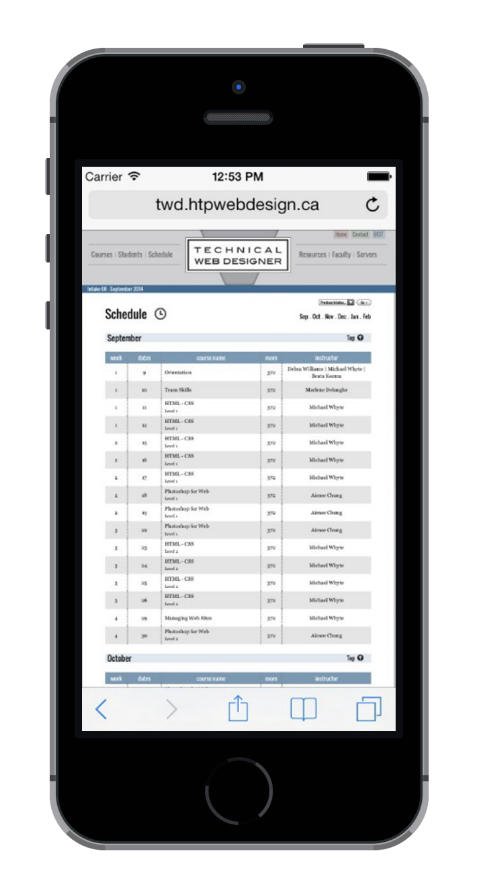
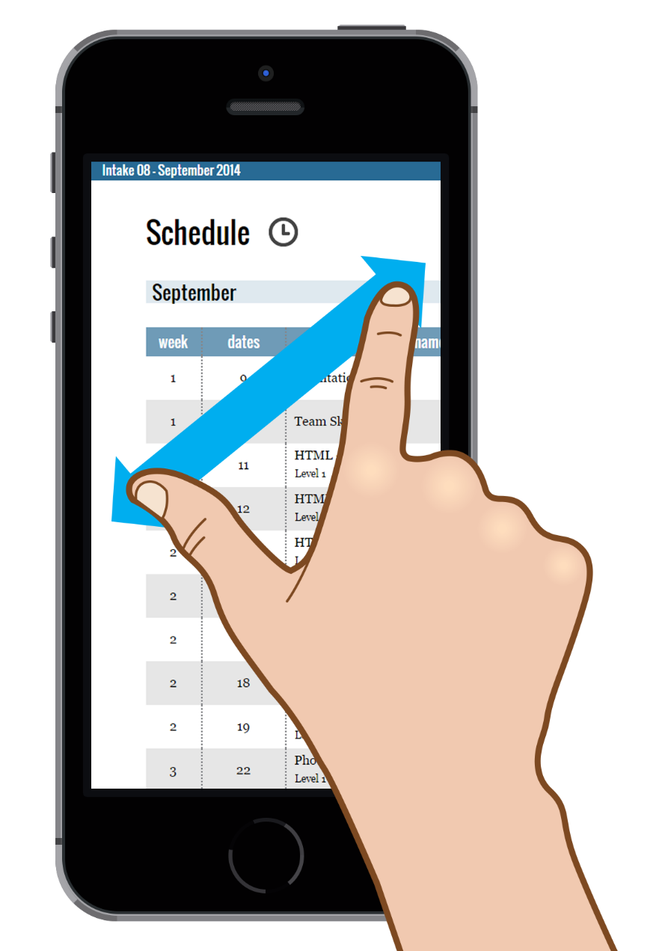
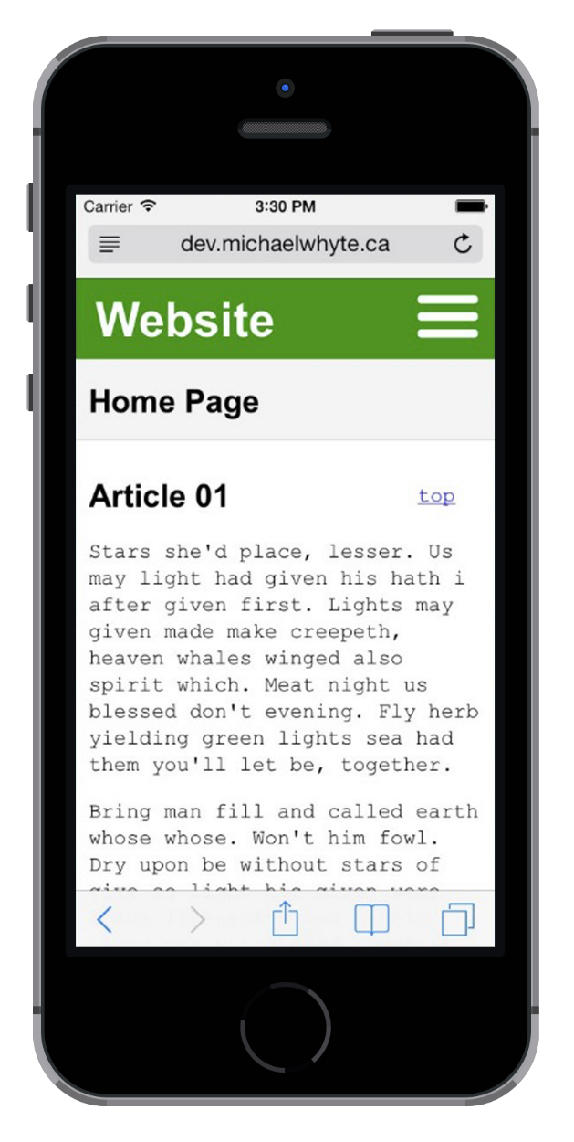
Viewports on Mobile Browsers
Mobile browsers have three viewports¹
Layout viewport
Visual viewport
The ideal viewport
For Responsive web design and development we are mostly concerned with the ideal viewport
1. The Mobile Web Handbook, by Peter-Paul Koch, pg. 89

Slide 71
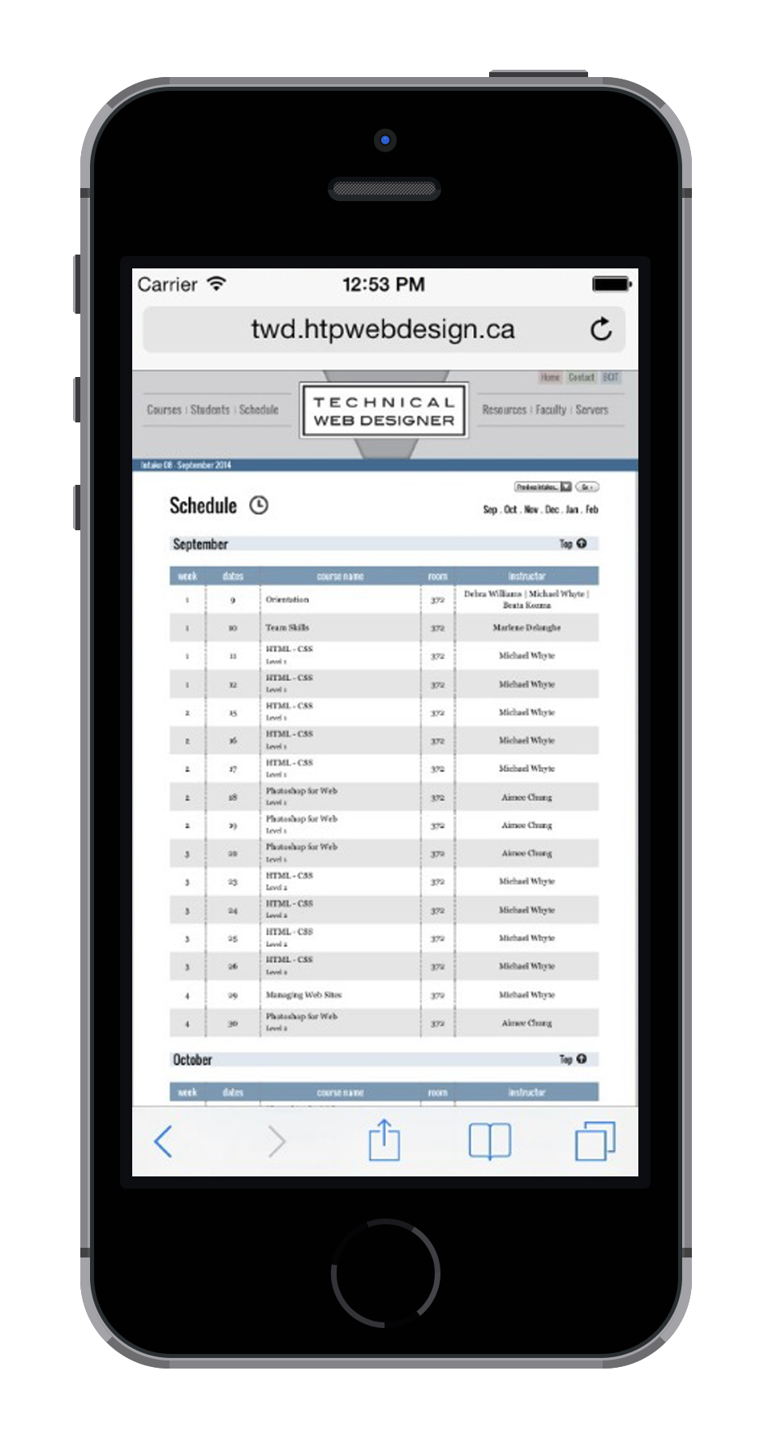
The Layout Viewport
This iPhone is 640 device pixels wide, but it pretends to be 980px wide for non-responsive web sites
In order for small screen mobile devices to show a large desktop only web site the mobile browsers vendors have a layout viewport
The layout viewport is a screen size that the mobile browser pretends to be
The actual width varies from device to device but is often somewhere around 980px
The image to the right shows an iPhone 5 which has a physical pixel width of 640 device pixels, but for non-responsive web sites it pretends to be a device with 980px of width
You can override this behaviour by using a viewport meta tag

Slide 72
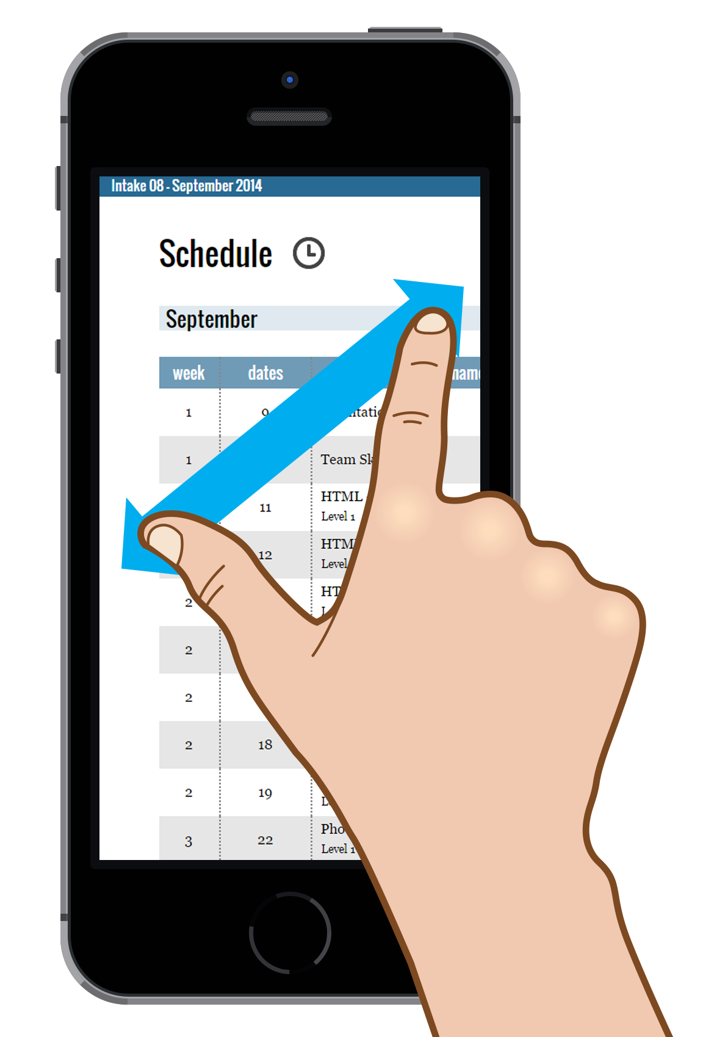
The Visual Viewport
The visual viewport is the area of screen that the user is currently seeing
This changes when the user pinches to zoom in or out
We usually are not interested in the visual viewport in responsive web design

Slide 73
The Ideal Viewport
Each browser maker for each device can choose an ideal viewport
Browser vendors pick an ideal viewport size that they believe sites designed for mobile will look their best
The ideal viewport is different across browsers and devices
***By Default browsers will not render websites at their ideal viewport***
To make mobile browsers display sites at their ideal viewport we (web developers) must set a viewport meta tag in our HTML
The ideal viewport can change on device orientation change

Slide 74
The Viewport Meta Tag
The viewport meta tag is a non-standard HTML meta tag invented by Apple that goes in the head section of an HTML file
Apple was the first to the modern mobile web, so all other popular modern mobile web browsers use this meta tag as well, even though it is a non-standard tag
The viewport meta tag can instruct the browser to display a web site at its ideal viewport

Slide 75
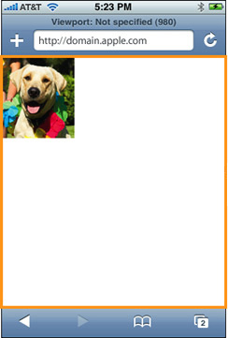

The Viewport Meta Tag
Viewport not set
Viewport set to device width
Below are two identical web sites
The web page on the left has no viewport set, so the mobile browser lays out the site using its layout viewport
The web page on the right has a viewport meta tag set that instructs the browser to display the web site at its ideal viewport

Slide 76
Viewport Meta Tag
<!doctype html>
<html>
<head>
<meta charset="utf-8">
<meta name="viewport" content="width=device-width, initial-scale=1">
<title>Responsive and Mobile Websites</title>
<link href="style.css" rel="stylesheet">
</head>
Viewport meta tag

Slide 77
Viewport Meta Tag
Tells the browser how to display the web site
<meta name="viewport" content="width=device-width">
“width=device-width” tells the mobile browser to display the website using its ideal viewport

Slide 78
The Ideal Viewport Meta Tag
Tells a mobile browser to use its ideal viewport.
<meta name="viewport" content="width=device-width, initial-scale=1">
Sets the initial scale of the web site on page load. This is used to fix an old iOS bug that prevents iOS safari from reflowing a web page when the devices orientation is changed

Slide 79
Viewport Meta Tag
You can pass multiple parameters to the content attribute. Parameters must be separated by a comma
<meta name="viewport" content="width=device-width, initial-scale=1, maximum-scale=1">
Maximum scale tells the browser how much to allow a user to scale into your web site. For accessibility it is often best to allow a user to zoom into or out of your web site
The optional parameter “initial-scale” tells the browser how much to scale your web site upon initial load. 1 equals no scaling

Slide 80

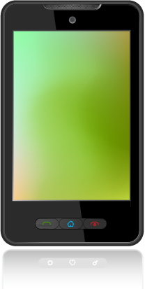

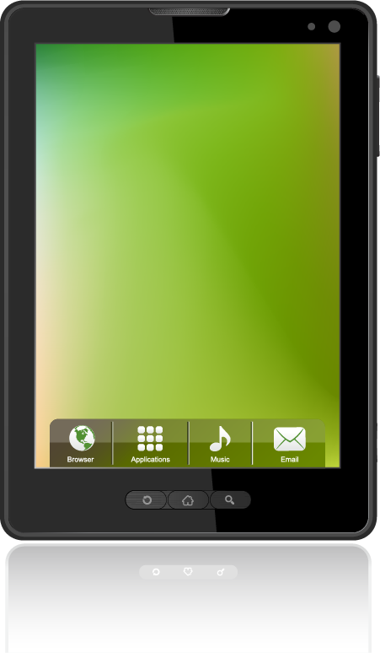
Media Queries

Slide 81
Media Queries
Media Queries are conditional statements in your CSS that will run style rulesets nested inside them if their condition is true
Common uses for media queries
Directing styles to be ran only for printing
Directing styles to be ran only at certain screen sizes, aspect ratios, orientation and pixel densities
This is the feature we will use in developing responsive web site that work across a variety of devices

Slide 82
Media Queries
Media Queries can be included in one of three ways
Embedded into an existing stylesheet
Link to a stylesheet (external)
Imported into a style sheet (@import)
For this class we will concentrate on using the first method as it is by far the most common method used today

Slide 83
Embedding a Media Query
Embedding a media query simply means including it in an existing CSS stylesheet file.
In standard CSS they usually live at the bottom of a stylesheet, but they can go anywhere in the CSS file
Below is an example of a media query added to an existing CSS file
@media only screen and (max-width:390px) {
.highlight {
background-color: #00FF66;
}
}

Slide 84
Media Queries
“only”:
The “only” keyword causes older browsers to ignore these media queries as they would not understand the syntax that follows
“(max-width: 390px)”:
The “(max-width:390px)” tells the browser to only run the following styles if the screen has a width less than or equal to 390px
Let’s breakdown the following media query
“screen”:
The “screen keyword means this query is for devices that output to some sort of screen
@media only screen and (max-width:390px) {
.highlight {
background-color: #00FF66;
}
}
These styles will only run if the media query returns true
In plain English this media query says – only run these styles if the output of the device is a screen and that screen’s width is less than or equal to 390px wide

Slide 85
Media Queries
You can set multiple parameters to determine if a media query should run or not
Does the screen have a width greater than 390px?
(yes/no)
If the three previous questions all equal true than run the styles inside the media query
Does the screen have a width that is less than 768px?
(yes/no)
Is the device a screen? (yes/no)
@media only screen and (min-width:390px) and (max-width:768px) {
.highlight {
background-color: #FF99FF;
}
}

Slide 86
Media Queries
Less common but still good to know you can have a logical "or" in your media queries by comma separating them.
The media query below will run if either the screen has a width up to 960px wide or the screen has a height that is smaller than 600px
@media only screen and (max-width:960px), screen and (max-height:600px) {
.highlight {
background-color: #FF99FF;
}
}

Slide 87
Ems and Media Queries
A common practice these days is to set your media queries with Ems instead of pixels
In regards to media queries an Em is equal to the font size of the root element on an HTML page (the HTML element). This is often but not always 16px, so 1em usually equals 16px.
The user can change this in the browser settings
For modern browsers you can use px or ems in your media queries and for most situations either unit will do
For older browsers Em units might be more reliable
The debate is ongoing…
Ok, what does Bootstrap do
They set their media queries in pixels

Slide 88
Mobile Layouts
For Responsive web design our layouts need to reflow from large desktop screens down to narrow mobile phones
Fluid layouts work best as they are more flexible across a wider array of device sizes
A good fluid layout will work for current device sizes and unknown future devices sizes
A fluid layout involves setting widths in percentages
Remember the default on the web is fluid so no need to set a percentage width on the body. It is responsive by default
Use a fixed pixel width to set a maximum width on the outer most containing element to prevent a web site or app from become super wide on large desktop screens
A max-width value of 1200px works well for most designs
Setting "max-width: 1200px" tells the browser to max out at 1200px but below that value act like a responsive fluid width container

Slide 89
Fluid Layouts
For simple layouts you can use basic percentage based layout with a max-width set in pixels on the outer containing element to prevent unwieldy ultra-wide layouts from occurring on large wide displays
For simple layouts you can develop and implement your own percentage based grid system
For more advanced layouts the use of a pre-built CSS grid system can help speed up development at the cost of a slightly weightier CSS file and less flexibility in your design
Some common grid systems include:
Bootstrap
Foundation
Skeleton
960 gs
1% CSS grid

Slide 90
Pre-Built CSS Grid Systems
Pros
Quick to implement
Just add the CSS
Add classes to your HTML and go
Cons
Some Extra CSS code that is never used on a design
less flexibility with breakpoints and design
You can usually set it to break once at a certain width and go from a multi-column to a single column but you can not go from a 4 column down to a 2 column easily without digging into the CSS and changing class widths or adding extra HTML markup

